Slide 1



Therapeutic group home for youngsters who experienced trauma
Sille Saidlo
Trauma and Youth care advisor
SOS Children’s Village, Estonia
September 2024
© Cornel van Heerden | Mozambique

Slide 2
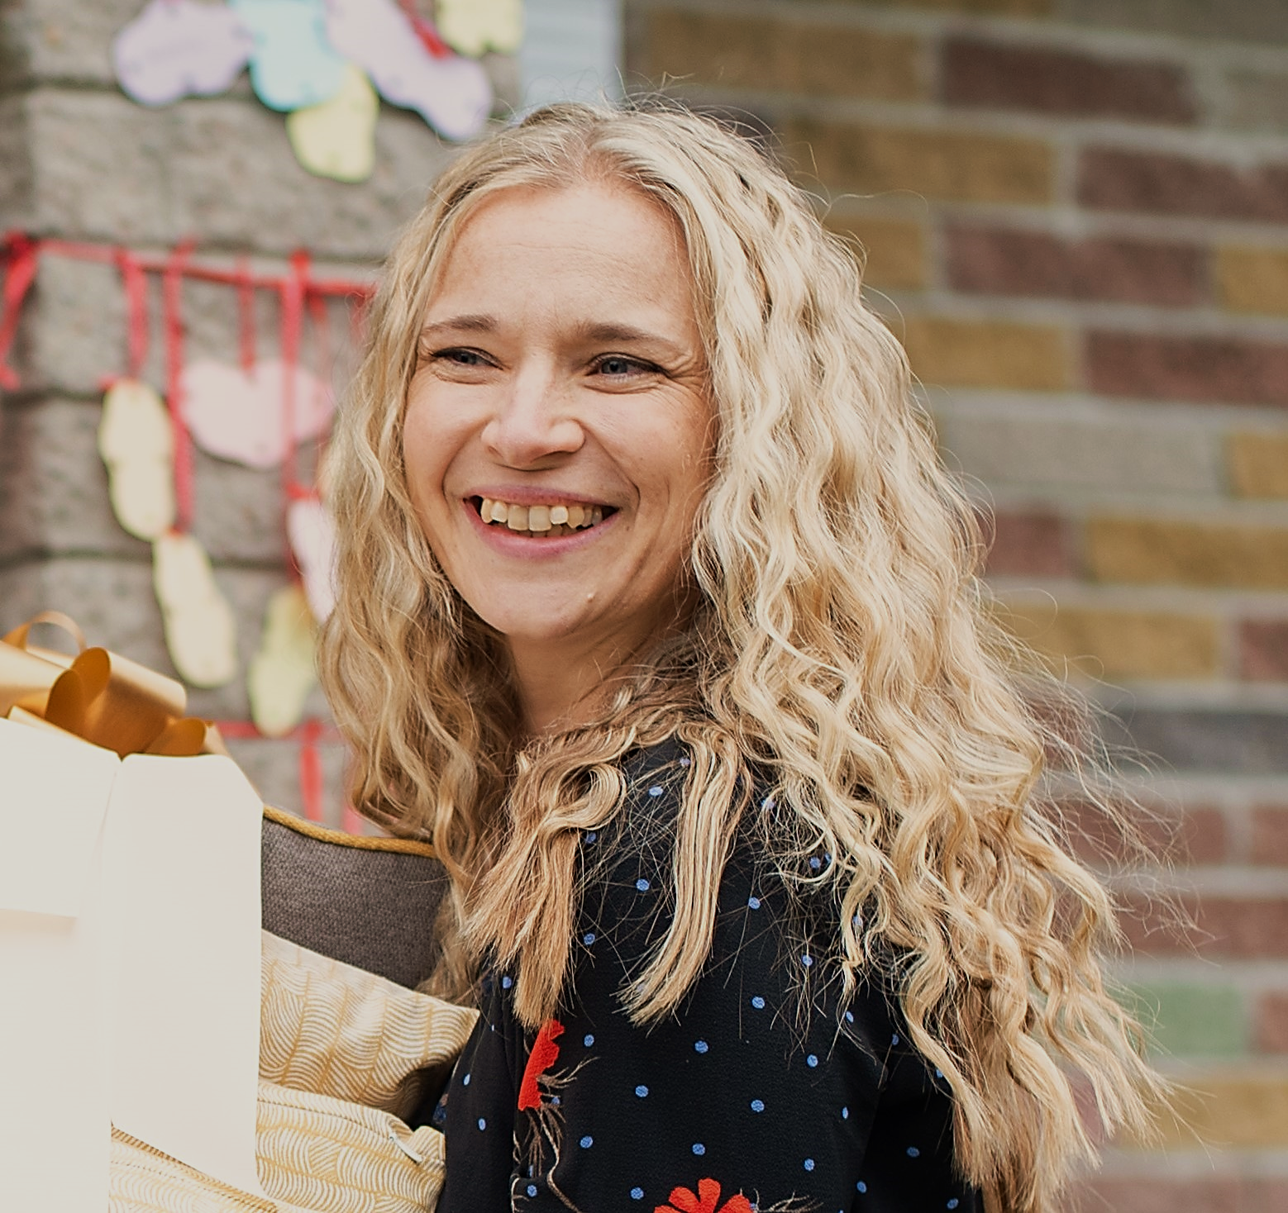
SILLE SAIDLO
Higher education in youth work.
Active in dealing with youth since 1995.
International and volunteer work involving children and youth in Denmark, England, India and Malawi over period of 8 years.
Working in children’s psychiatric inpatient unit for 8 years.
Last 10 years working in SOS Children’s village: starting in youth home and leading our trauma-pedagogy- based group home from its start in April 2021.
Trauma and youth care advisor in SOS Children’s village from September 2023.

Slide 3
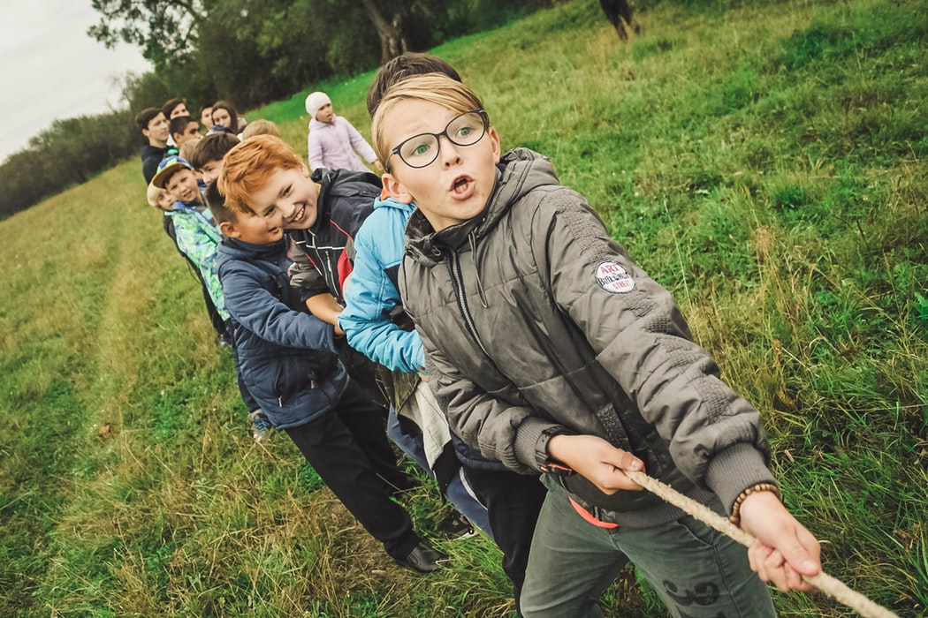
Situation in Estonia
2600 children without parental care
Aprrox. 400 per year are separated from families
Approx. 900 of them living in alternative care (229 in SOS system/2022)
SOS CV EXTRA SERVICES
832 children/youth benefit from our family strengthening programme
SOVA chat for children 12+
Individual service 1+1
SMALL GROUP HOME with the approach of trauma pedagogy
© Austria

Slide 4
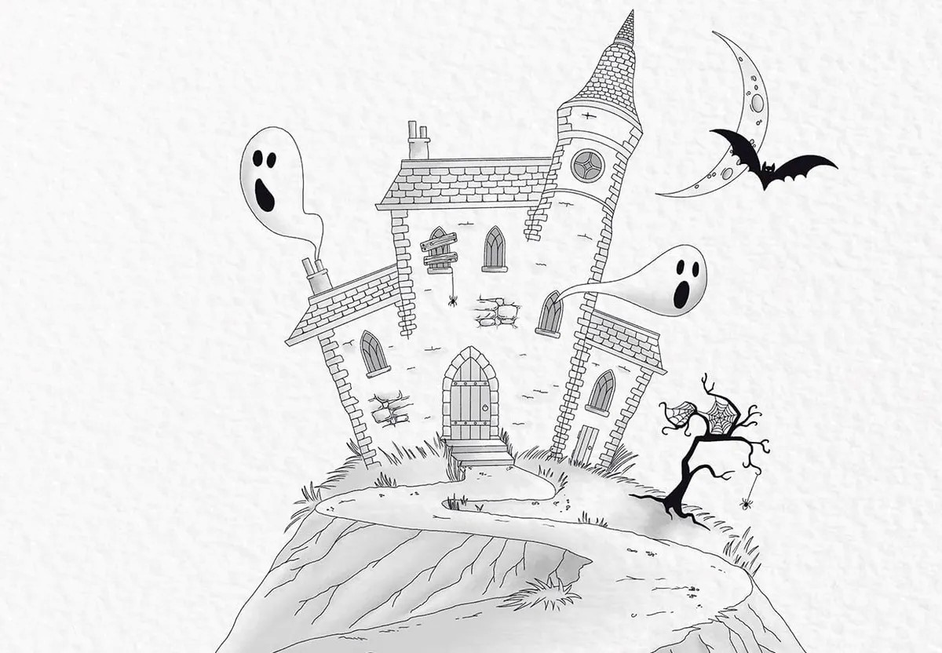

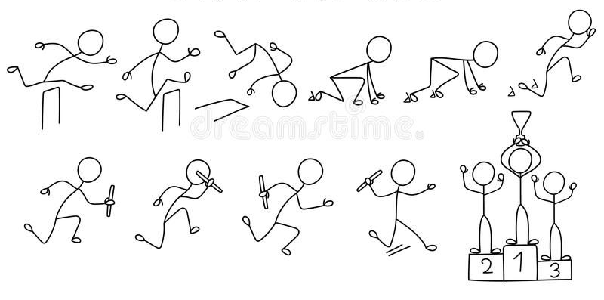
Gathered

Slide 5
WHY?
Growing number of children who did not match in family- based care – at least one child in every program – children in need of special care!
The situation with some youngsters went in direction that they needed closed institution (their behavior, their understanding, their needs) and no alternative was available.
Attitude in society - after the closed institution nobody wants those children – they behave “bad”, they don’t have family, people are scared etc.
Possibility to stay in our care – if we develop a service and will provide it.

Slide 6


Service design components
Decision!
– alternative care – we will focus on what we are. Family type care (6 youngsters).
Target group- What age? Boys/girls together? Exclusions?
Method or approach - looking for the “right thing”, best solution.

Slide 7
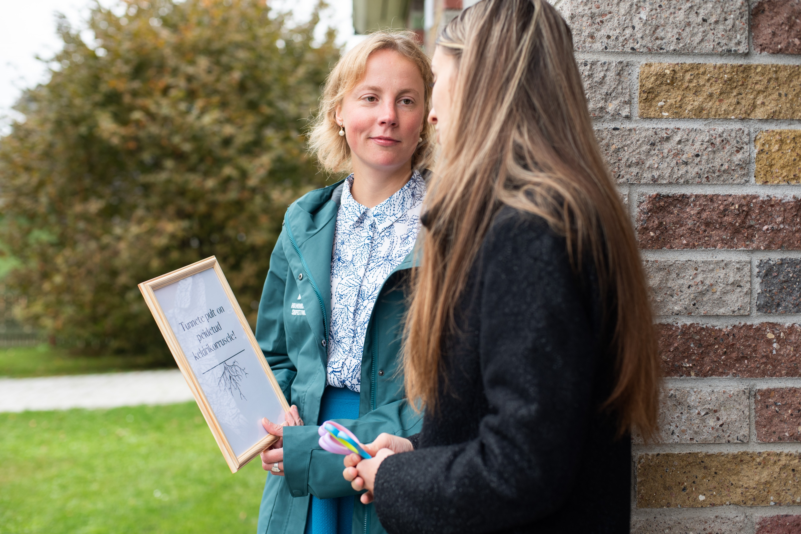
Preparations
Concept paper
Recruitment plan – working experience before
Training about Trauma
Training about Trauma pedagogy
Study visit
Practice
Start!! – kick off!!
Full house step-by step

Slide 8

“Silent home” is a group home
For youth between 14-18 years of age
The background of youngsters – traumatized, aggressive, with behavioral challenges etc.
Have already been in closed institution (special school) or are in the waiting list
6 places (boys and girls together)
Law - Family type care (alternative care) in a private house
Caregivers - 9 social pedagogues – working on shifts
INCOME IS COVERED BY
Local governments that buy our service.
Our fundraising team in national office-sponsors, both companies and individual donations.

Slide 9
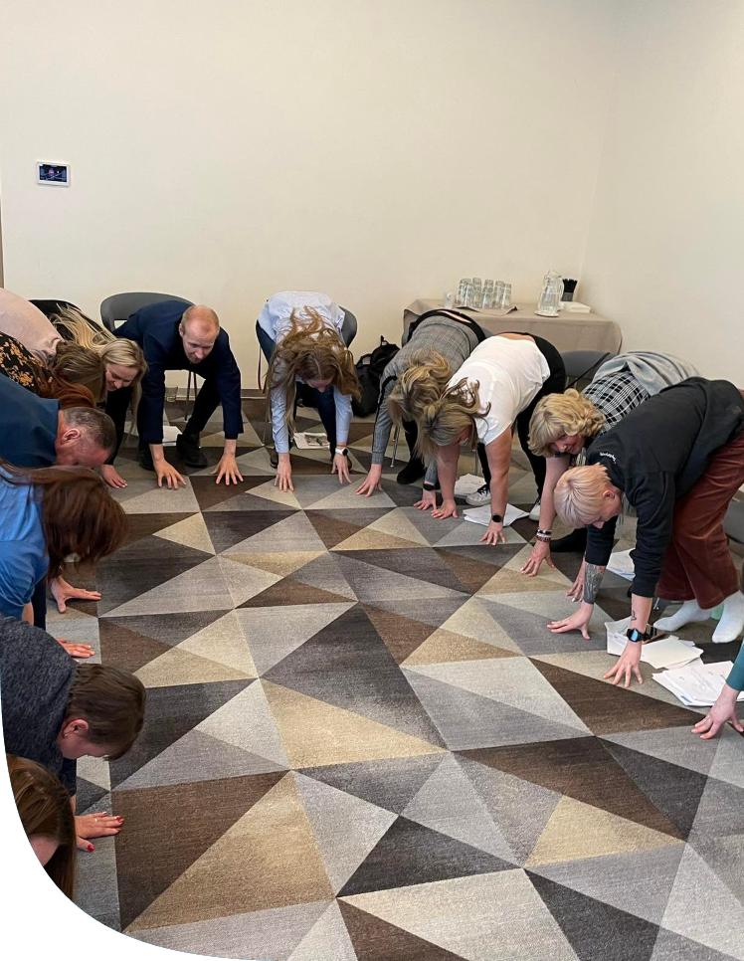
We have
a group home LEADER.
the joy of 2 social PEDAGOGUES at home around the clock.
team MEETINGS every Tuesday.
SUPERVISIONS for group (up to 10x a year) and
individual needs (4-8 times a year).
trauma-pedagogy THEME DAYS 4 times a year to stay focused.
possibility to ask for ADVICE from trauma and
youth work advisor.
TRAININGS offered from organization at least twice a year.

Slide 10

We stand on
Trauma-pedagogical approach.
Being as home-like as possible, incl chores ;).
Individual work with youngsters.
Group-work with youngsters.
Cooperation between institutions.
Explaining trauma with its consequences in institutions that work with our youngsters.
Staff resilience.
Keeping calm.
New, trusting ways of communication for youngsters.

Slide 11

Trust and believe
Fear and worry
In yourself
in your team
In your method.
In your gut.
In life and all its happenings.
In open communication.
Of someone getting hurt
Of not knowing if you can or are able to help.
Of being wrong, saying wrong, doing wrong…
Of creating chaos.
Of solving chaos.
To maintain a safe place or at least safest place possible.

Slide 12
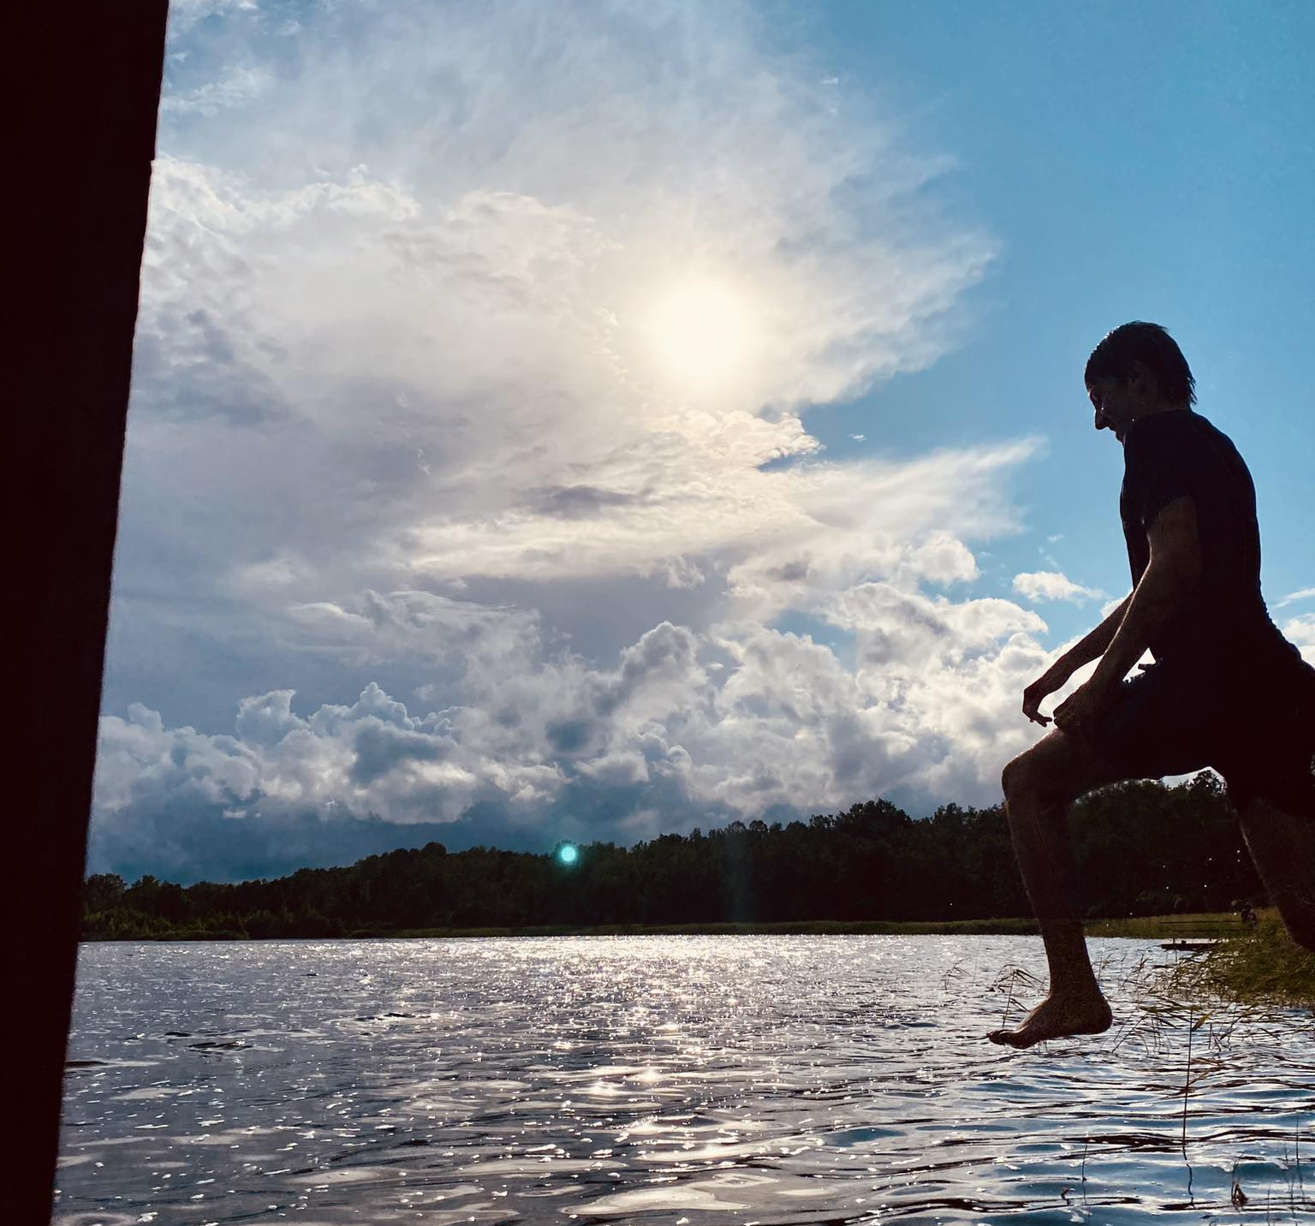
Curiosity and clarity
To keep information available and as simple as possible.
To be inspired by the energy of young people…
…and make something positive out of it
To be present while at home (work-home ☺).
To be brave enough for “simple tasks”.

Slide 13
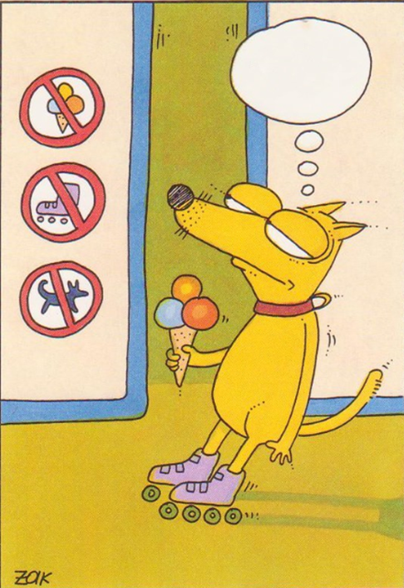

Support or power position?
Humane pedagogical attitude needs few rules.
Justice doesn’t equal equality but covering everyone's needs.
Let the youngster know if you cannot agree with his/her action or behavior and explain, why. EVERY TIME! It is his/her choice in the end, but you have given him/her a choice.
Perfect result, whatever it may be in someone’s eyes, can never be a goal and social pedagogue’s responsibility.

Slide 14

Love and notice
What you and others do.
.
Coming back to
your method.
The people you work with, both youngsters and colleagues.
Even smallest
Progress.
The possibility to change how stories end.

Slide 15

Masterpiece of creativity ☺
Find ways to acknowledge young people!
Be interested!
Care! Also, about yourself!
Read!
Think, discuss, analyze!
Be honest!
Be yourself!
Ask for advice or experience!
Communicate!
Listen!
Know your attachment style!
Assuming is the mother of most troubles!
Notice good and positive things!
…BECAUSE THERE IS NOT AND NEVER WILL BE “A MANUAL FOR CORRECT REACTIONS AND BEHAVIORS FOR ALL OCCASIONS”!

Slide 16


Aitäh osalemast!
Sille Saidlo
Sille.saidlo@sos-lastekyla.ee
Thank you!
Sille Saidlo
Sille.Saidlo@sos-lastekyla.ee
September 2024

